Slide 1


Used Cars Price Prediction
Presented by:
Bhavya priya N
Abinaav Elango
Aravindan V
Sharen Govindaraj
Sudharsan S
Prakash D L
Guided by:
Ms. Anjana Agarwal

Slide 2

1. Problem Statement
Predicting the prices of used cars accurately

Slide 3
1. Problem Statement
Predicting the prices of used cars accurately
2. Solution
Developed a machine learning model for price prediction

Slide 4
1. Problem Statement
Predicting the prices of used cars accurately
2. Solution
Developed a machine learning model for price prediction
3. Data Collection
Historical used car sales data with relevant features

Slide 5
1. Problem Statement
Predicting the prices of used cars accurately
2. Solution
Developed a machine learning model for price prediction
3. Data Collection
Historical used car sales data with relevant features
4. Machine Learning Techniques
Regression, Random Forest, Gradient Boosting, XGBoost…

Slide 6
1. Problem Statement
Predicting the prices of used cars accurately
2. Solution
Developed a machine learning model for price prediction
3. Data Collection
Historical used car sales data with relevant features
4. Machine Learning Techniques
Regression, Random Forest, Gradient Boosting, XGBoost…
5. Model Training
Learning patterns and relationships from the data

Slide 7

Empowering Sellers
Why it is important ?

Slide 8
Empowering Sellers
Informed Buying Decisions
Why it is important ?

Slide 9
Empowering Sellers
Informed Buying Decisions
Why it is important ?
Market Efficiency

Slide 10
Empowering Sellers
Informed Buying Decisions
Why it is important ?
Market Efficiency
Better Market Transparency

Slide 11


Enhancements and Value Additions📈
Advanced Feature Engineering

Slide 12
Enhancements and Value Additions📈
Integration with Vehicle History Reports
Advanced Feature Engineering

Slide 13
Enhancements and Value Additions📈
Integration with Vehicle History Reports
Integration of Market Trends
Advanced Feature Engineering

Slide 14
Enhancements and Value Additions📈
Integration with Vehicle History Reports
Integration of Market Trends
Advanced Feature Engineering
Build Models with various Algorithms

Slide 15
Enhancements and Value Additions📈
Integration with Vehicle History Reports
Integration of Market Trends
Advanced Feature Engineering
Build Models with various Algorithms
Transparency and Explanation

Slide 16
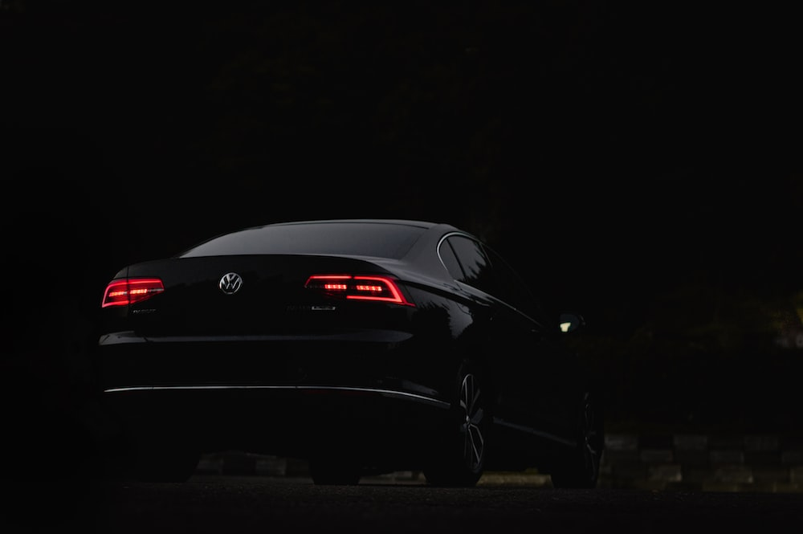
Suggested Solutions !
Developed a machine learning model for accurate prediction of used car prices.
Leveraged advanced algorithms and techniques to optimize price estimation.
Aimed to enhance transparency, fairness, and efficiency in the used car market.

Slide 17
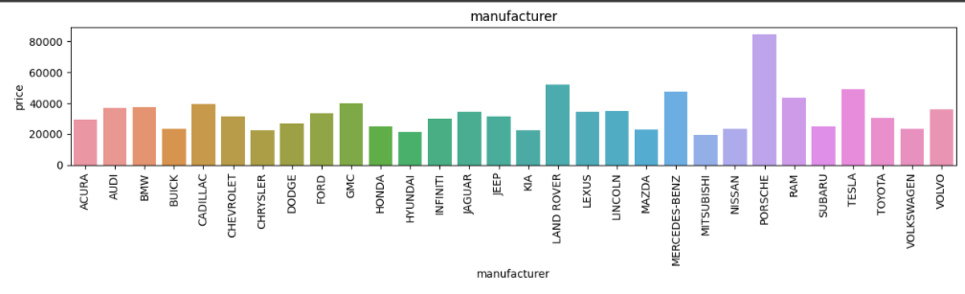
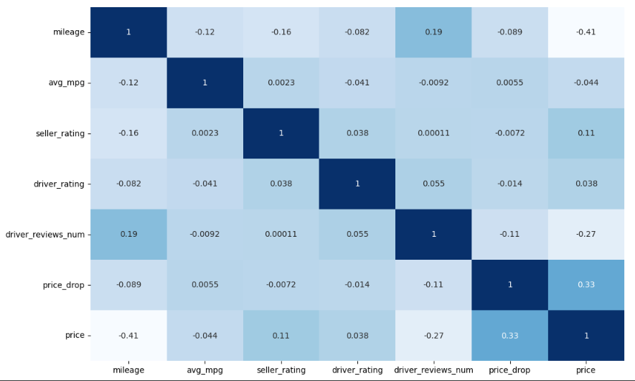
EDA
Price range is almost similar for all manufacturer except Porsche
There is no strong correlation between price and any numerical variable

Slide 18
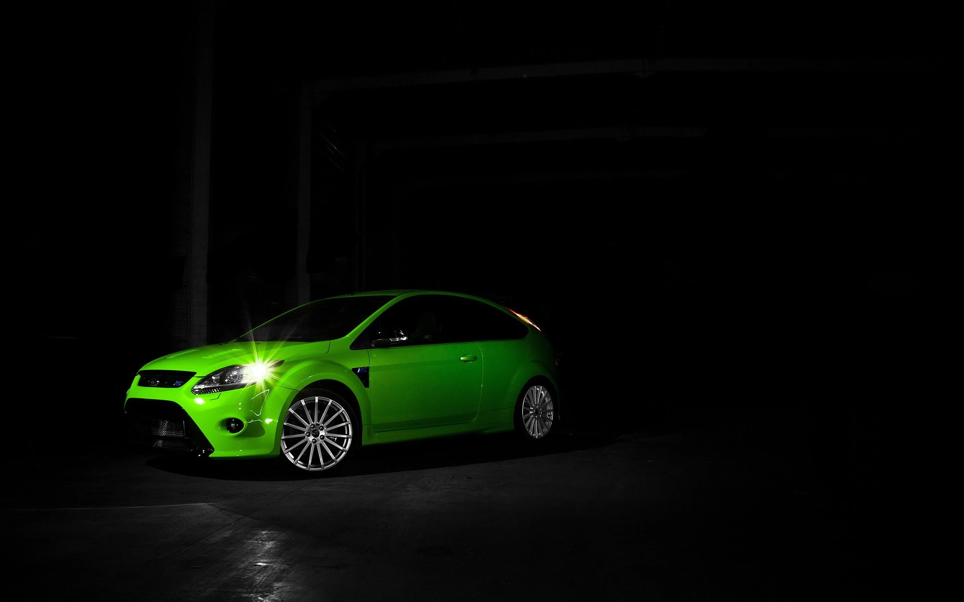
Base Model – Linear Regression
Variables which has Positive influence on price:
Manufacturer
Year
Drivetrain
Fuel type
Average miles per gallon
Exterior and interior color
One-owner history
Personal use only
Seller rating
Driver rating
Driver reviews count.
Variables which has Negative influence on price:
Mileage – Miles driven by the car
Accidents or Damage
R-Squared – 0.453
Adjusted R-Squared – 0.453

Slide 19
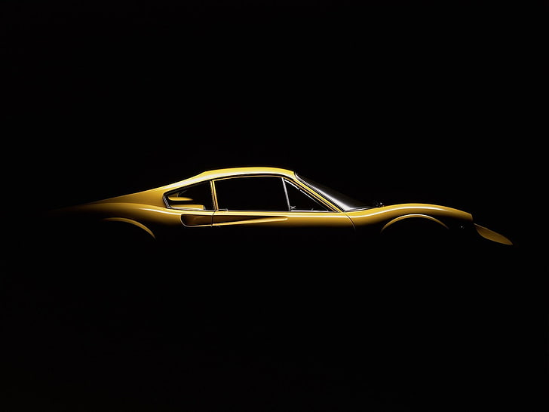
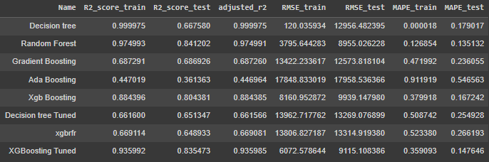
Comparison of Regression Algorithms for Used Cars Price Prediction
1. Decision tree regressor
2. Random Forest Regressor
3. Gradient Boosting Regressor
4. Ada Boost Regressor
5. Xgb Regressor
6. XGBoost Random Forest Regressor

Slide 20
Comparison of Regression Algorithms for Used Cars Price Prediction
1. Decision Tree Regressor
Pros: High training R2 score, low RMSE on train data.
Cons: Relatively low test R2 score, high RMSE on test data, potential overfitting.

Slide 21
Comparison of Regression Algorithms for Used Cars Price Prediction
1. Decision Tree Regressor
Pros: High training R2 score, low RMSE on train data.
Cons: Relatively low test R2 score, high RMSE on test data, potential overfitting.
2. Random Forest Regressor
Pros: Good R2 scores on both train and test data, lower RMSE compared to other models.
Cons: Higher computational complexity, potential overfitting with a large number of trees.

Slide 22
Comparison of Regression Algorithms for Used Cars Price Prediction
1. Decision Tree Regressor
3. Gradient Boosting Regressor
Pros: Moderate R2 scores, better performance than decision tree and Ada Boosting.
Cons: Higher RMSE compared to Random Forest, potential overfitting with excessive boosting rounds.
Pros: High training R2 score, low RMSE on train data.
Cons: Relatively low test R2 score, high RMSE on test data, potential overfitting.
2. Random Forest Regressor
Pros: Good R2 scores on both train and test data, lower RMSE compared to other models.
Cons: Higher computational complexity, potential overfitting with a large number of trees.

Slide 23
Comparison of Regression Algorithms for Used Cars Price Prediction
1. Decision Tree Regressor
3. Gradient Boosting Regressor
Pros: Moderate R2 scores, better performance than decision tree and Ada Boosting.
Cons: Higher RMSE compared to Random Forest, potential overfitting with excessive boosting rounds.
Pros: High training R2 score, low RMSE on train data.
Cons: Relatively low test R2 score, high RMSE on test data, potential overfitting.
2. Random Forest Regressor
4. Ada Boosting Regressor
Pros: Good R2 scores on both train and test data, lower RMSE compared to other models.
Cons: Higher computational complexity, potential overfitting with a large number of trees.
Pros: Moderate R2 scores, improvement over a single decision tree model.
Cons: Lower R2 scores compared to Random Forest and Gradient Boosting, higher RMSE values.

Slide 24
Comparison of Regression Algorithms for Used Cars Price Prediction
5. XGBoost Regressor
Pros: High R2 scores on both train and test data
relatively low RMSE values.
Cons: Longer training time compared to decision
tree-based models, potential parameter tuning complexity.

Slide 25
Comparison of Regression Algorithms for Used Cars Price Prediction
5. XGBoost Regressor
Pros: High R2 scores on both train and test data
relatively low RMSE values.
Cons: Longer training time compared to decision
tree-based models, potential parameter tuning complexity.
6. XGBRFR (XGBoost Random Forest Regressor)
Pros: Good R2 scores, similar performance to the tuned decision tree model.
Cons: Relatively high RMSE values, longer training time compared to simpler models.

Slide 26
Comparison of Regression Algorithms for Used Cars Price Prediction
5. XGBoost Regressor
7. Decision Tree Tuned
Pros: High R2 scores on both train and test data
relatively low RMSE values.
Cons: Longer training time compared to decision
tree-based models, potential parameter tuning complexity.
Pros: Improved R2 scores compared to the untuned decision tree.
Cons: Relatively high RMSE values, potential overfitting.
6. XGBRFR (XGBoost Random Forest Regressor)
Pros: Good R2 scores, similar performance to the tuned decision tree model.
Cons: Relatively high RMSE values, longer training time compared to simpler models.

Slide 27
Comparison of Regression Algorithms for Used Cars Price Prediction
5. XGBoost Regressor
7. Decision Tree Tuned
Pros: High R2 scores on both train and test data
relatively low RMSE values.
Cons: Longer training time compared to decision
tree-based models, potential parameter tuning complexity.
Pros: Improved R2 scores compared to the untuned decision tree.
Cons: Relatively high RMSE values, potential overfitting.
6. XGBRFR (XGBoost Random Forest Regressor)
8. XGBoosting Tuned
Pros: Good R2 scores, similar performance to the tuned decision tree model.
Cons: Relatively high RMSE values, longer training time compared to simpler models.
Pros: High R2 scores, improved performance over the untuned XGBoost model.
Cons: Relatively high RMSE values, longer training time compared to simpler models.

Slide 28
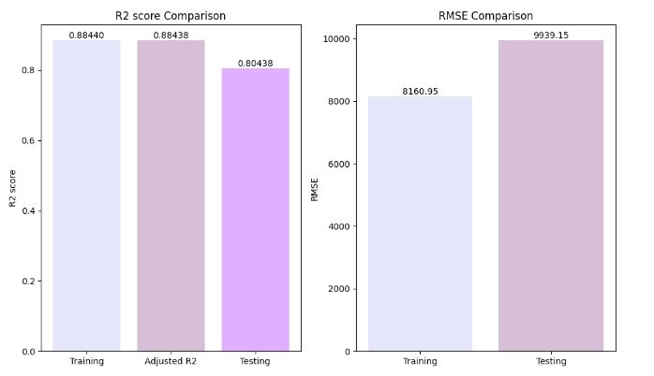
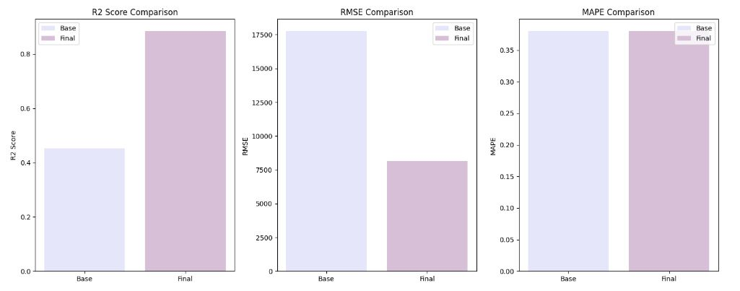
Results
Out of other models XGBoost has performed well
Comparison to base model with XGBoost model

Slide 29
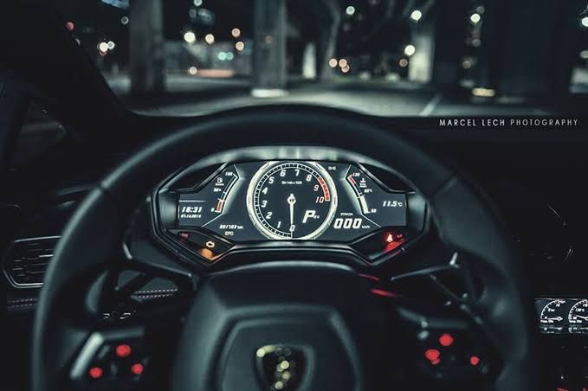
General Inferences
Inferences from Data Preprocessing
There are more cars with the fuel type Gasoline.
The average price based on the manufacturer is high for Prosche and less for Mitshubishi.
Electronically Continuous Variable Transmission (ECVT) gives more Mileage Per Gallon and the less is given by Semi Automatic.
Inferences from Data Modelling
Decision tree, Random Forest are overfitting and Ada boost is an underfitting model.
Rest all the models are Good but the RMSE difference is very high so it is potentially overfitting.
Comparing to all other models XGBoost is the better one.

Slide 30
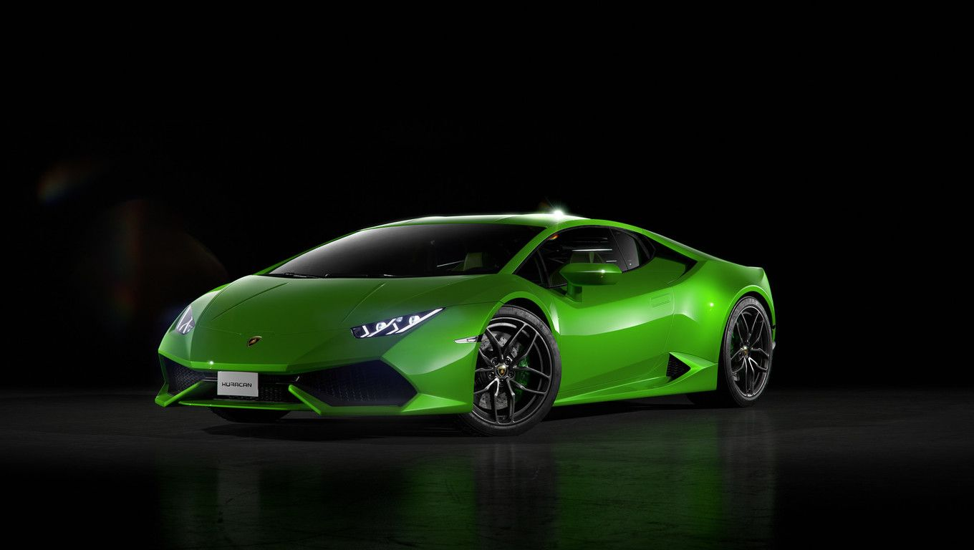
Business Recommendations
Features impacting the price more in used cars
Transmission
Body type of the car
Exterior color
Fuel type, Mileage
Manufacturer
Drive train

Slide 31

Thank You

